Slide 1
Colliding Galaxies: An application of the Restricted Three-Body Problem
Andrew Baldacchino
3rd Year Physics and Astronomy

Slide 2
Overview
Principle of Restricted Three-Body problem
Application
Initial setup
Galaxy generation
Stellar interaction
Further aims
Summary

Slide 3
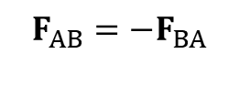
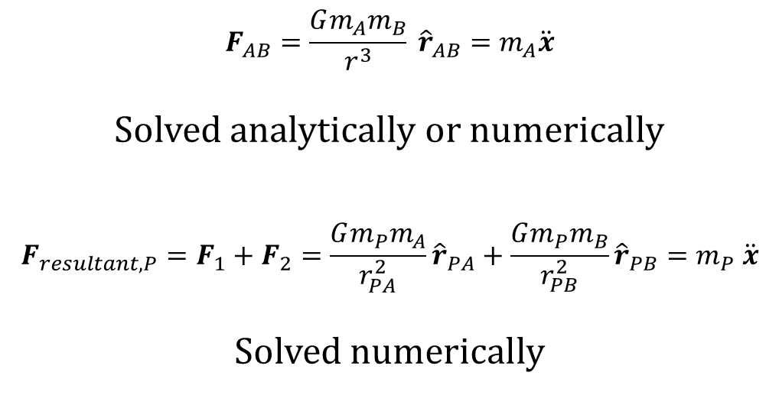
Restricted Three-Body Problem
$$F_{AB}=\frac{Gm_{A}m_{B}}{r^{3}} {\hat{r}}_{AB}=m_{A}\ddot{x}$$
Solved analytically or numerically
$$F_{resultant, P}=F_{1}+F_{2}=\frac{Gm_{P}m_{A}}{r_{PA}^{2}}{\hat{r}}_{PA}+\frac{Gm_{P}m_{B}}{r_{PB}^{2}}{\hat{r}}_{PB}=m_{P} \ddot{x}$$
Solved numerically
Test particle, P
[1]
F₁
F₂
B
F_{BA}
$$F_{AB}=−F_{BA}$$
F_{AB}
A
[1] – University Physics, Young and Freedman

Slide 4

Application
Two galactic cores modelled as point particles.
Stars act as test particles, only interacting with the two massive cores.
Star
F₁
F₂
B
F_{BA}
A
F_{AB}
$$F_{AB}=−F_{BA}$$

Slide 5
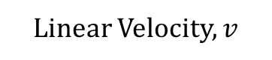
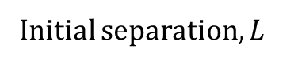

Initial Setup
Linear Velocity, $v$
Initial separation, $L$
Milky Way, M_{MW}
Andromeda, M_{A}
R_{MW}
R_{A}
Disk width, $h$

Slide 6
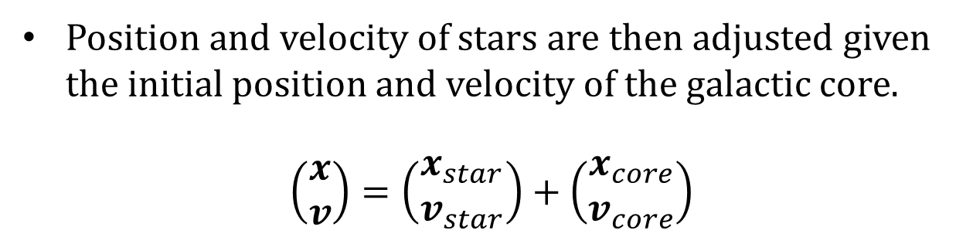
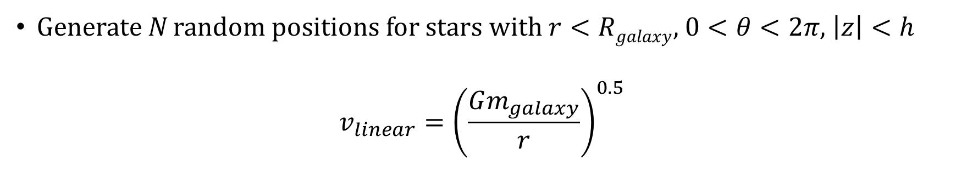
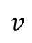
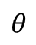
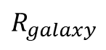
Galaxy generation
Generate N random positions for stars with $r<Rgalaxy$, $0<θ<2π$, $\left|z\right|<h$
$$v_{linear}={\left(\frac{Gm_{galaxy}}{r}\right)}^{0.5}$$
[1]
$$v$$
Position and velocity of stars are then adjusted given the initial position and velocity of the galactic core.
$$\left(\begin{matrix}x \\ v\end{matrix}\right)=\left(\begin{matrix}x_{star} \\ v_{star}\end{matrix}\right)+\left(\begin{matrix}x_{core} \\ v_{core}\end{matrix}\right)$$
$$θ$$
$$R_{galaxy}$$
[1] – University Physics, Young and Freedman

Slide 7
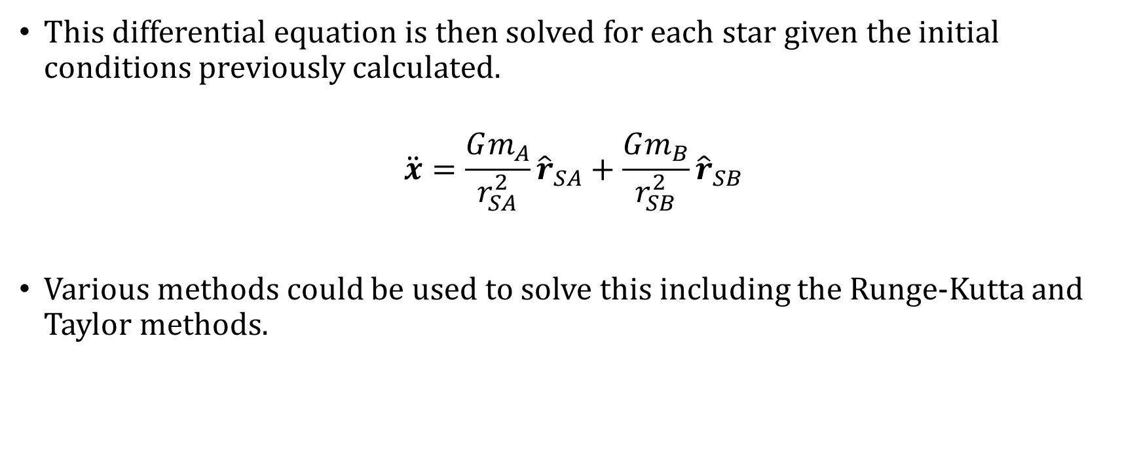
Numerical simulation
This differential equation is then solved for each star given the initial conditions previously calculated.
$$\ddot{x}=\frac{Gm_{A}}{r_{SA}^{2}}{\hat{r}}_{SA}+\frac{Gm_{B}}{r_{SB}^{2}}{\hat{r}}_{SB}$$
Various methods could be used to solve this including the Runge-Kutta and Taylor methods.

Slide 8
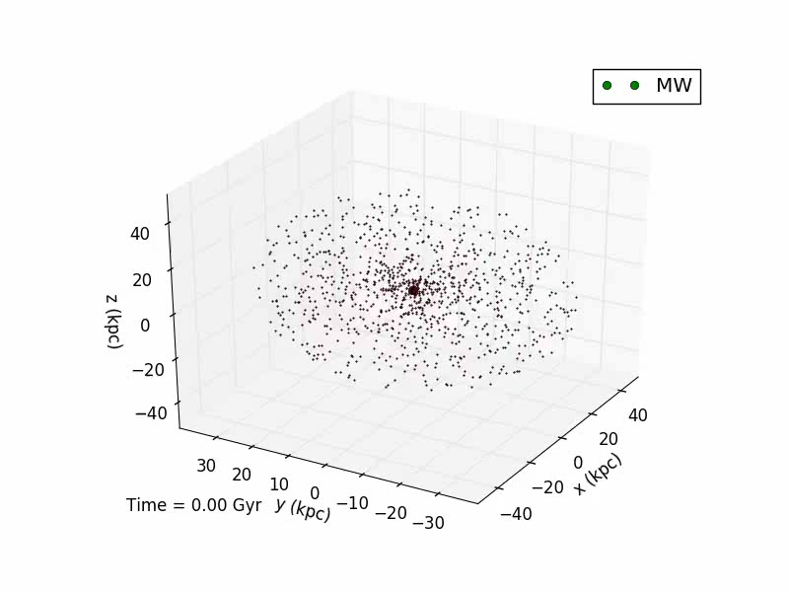
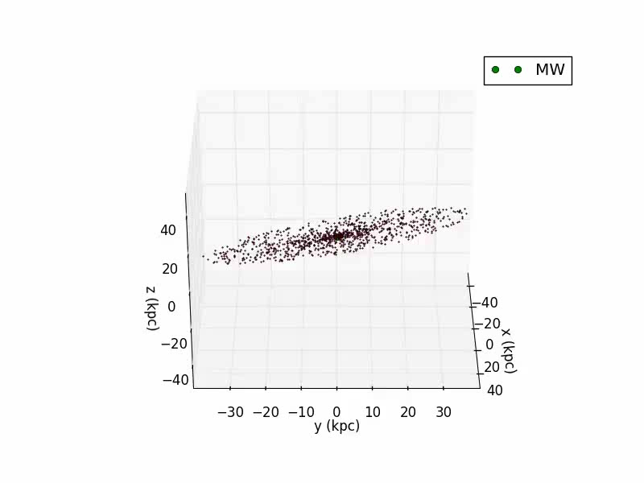
Stars orbiting galaxy

Slide 9
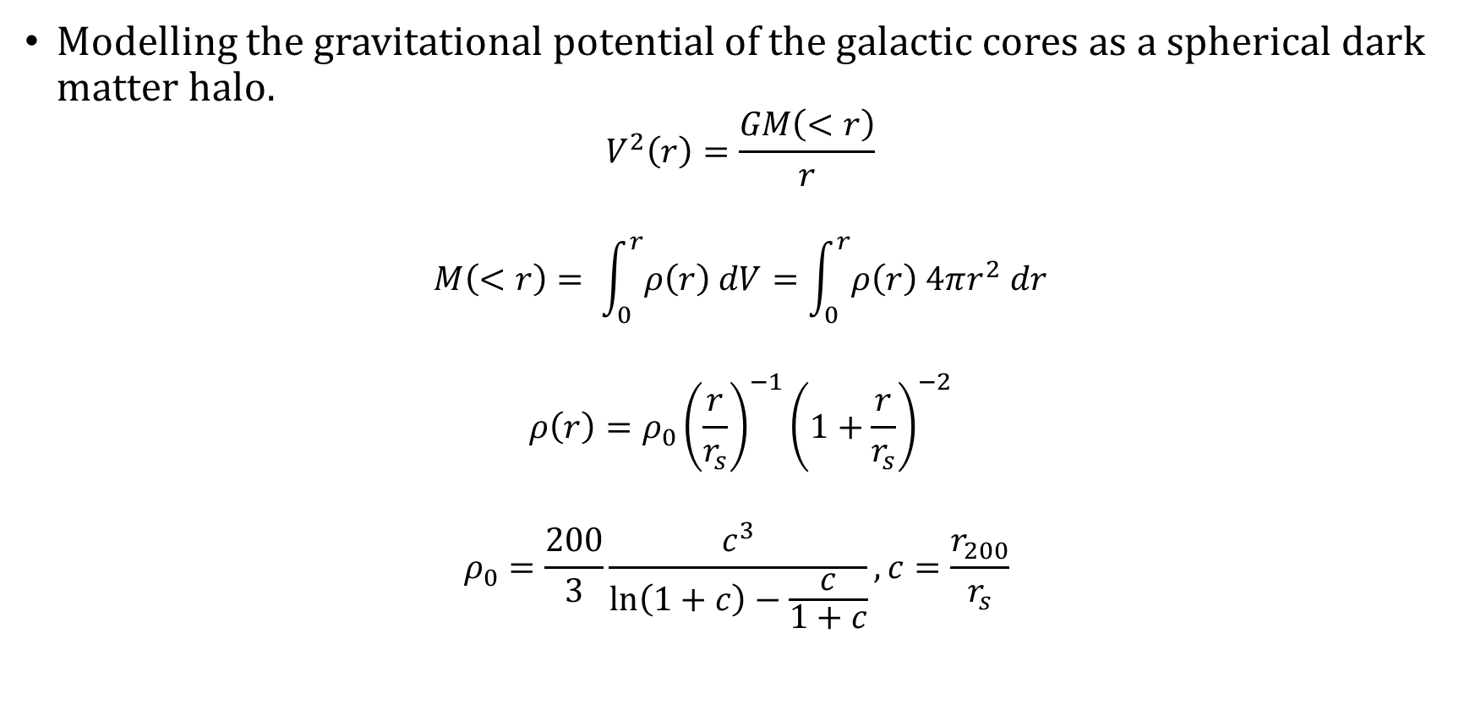
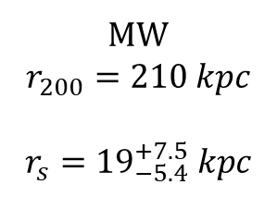
Further aims
Modelling the gravitational potential of the galactic cores as a spherical dark matter halo.
$$V^{2}\left(r\right)=\frac{GM\left(<r\right)}{r}$$
$$M\left(<r\right)= \int_{0}^{r}{ρ\left(r\right) dV}=\int_{0}^{r}{ρ\left(r\right) 4πr^{2} dr}$$
$$ρ\left(r\right)=ρ_{0}{\left(\frac{r}{r_{s}}\right)}^{−1}{\left(1+\frac{r}{r_{s}}\right)}^{−2}$$
$$ρ_{0}=\frac{200}{3}\frac{c^{3}}{\ln\left(1+c\right)−\frac{c}{1+c}}, c=\frac{r_{200}}{r_{s}}$$
[2]
MW
$$r_{200}=210 kpc$$
$$r_{s}={19}_{−5.4}^{+7.5} kpc$$
[2]
[2] – arXiv:1404.1938, J. I. Read

Slide 10
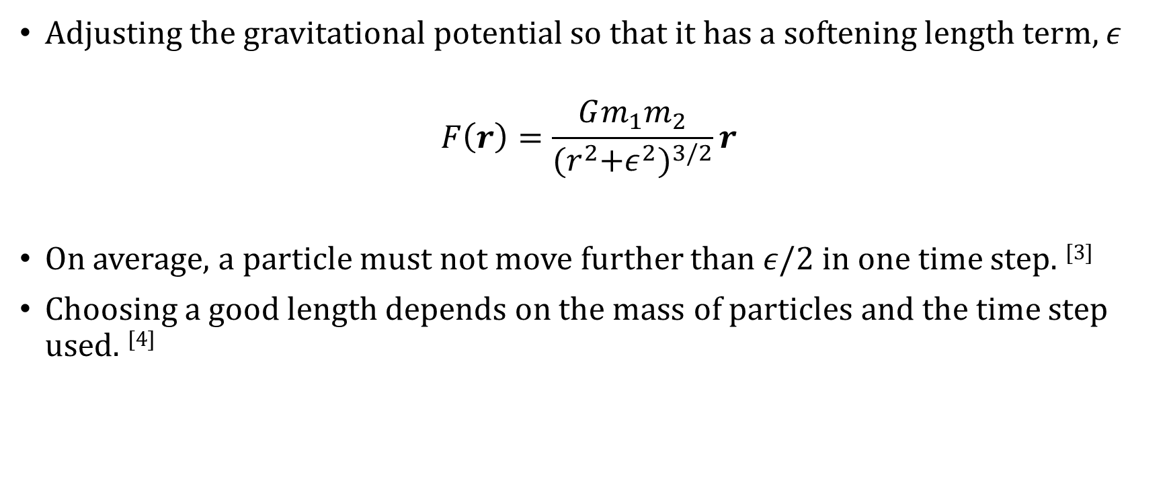
Further aims
Adjusting the gravitational potential so that it has a softening length term, $ε$
$$F\left(r\right)=\frac{Gm_{1}m_{2}}{{{(r}^{2}+ε^{2})}^{3/2}}r$$
On average, a particle must not move further than $ε/2$ in one time step. ^{[3]}
Choosing a good length depends on the mass of particles and the time step used. ^{[4]}
[3] – arXiv:astro-ph/0504573, S.A. Rodionov & N.Ya. Sotnikova
[4] – 2008MNRAS.391.1685S , V. Springel et al

Slide 11
Further aims
Structure to galaxy generation – elliptical galaxies and spiral galaxies.
Improve realism of simulation.
Investigate how more complex structures evolve when they have near galaxy interactions.

Slide 12
Summary
The aim of this project is to investigate the affects of galactic collisions on the stellar structure of galaxies.
This will be done using the restricted three body problem.
Further aims of the project are to increase the complexity of the simulation by modelling a dark matter halo, softening the gravitational potential and generating structured galaxies.

Slide 13
Thank you for listening!

Slide 14

Star
B
F_{BA}
A
F_{AB}
$$F_{AB}=−F_{BA}$$

